Slide 1


Slide 2

Define autoimmunity
Classifications of autoimmune diseases (local/systemic or generalized)
Failure in Immunological tolerance and autoimmunity (central vs peripheral)
Effects of autoimmunity
Effector mechanisms of autoimmunity
Examples of autoimmune diseases

Slide 3
Self/Non-self Discrimination
Autoimmunity is a problem of self/non-self discrimination.

Slide 4

5 % to 7% adult affected.
Two third women.
More than 40 human diseases autoimmune in origin.

Slide 5
Effects of autoimmunity
1) Tissue destruction
Diabetes: CTLs destroy insulin-producing b-cells in pancreas
2) Antibodies block normal function
Myasthenia gravis: Ab binds acetylcholine receptors
3) Antibodies stimulate inappropriate function
Graves’ disease: Ab binds TSH receptor
Mimics thyroid-stimulating hormone
Activates unregulated thyroid hormone production
4) Antigen-antibody complexes affect function
Rheumatoid arthritis:
IgM specific for Fc portion of IgG
IgM-IgG complexes deposited in joints inflammation

Slide 6
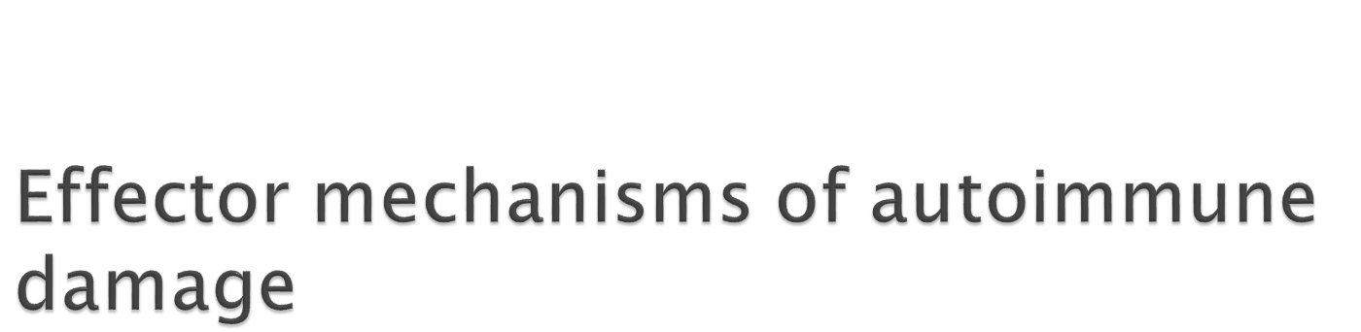
Specific components:
  Antibodies (majority)
  T cells
Nonspecific components:
  Complement
  Phagocytes (PMN and macrophages)
  NK and other cells

Slide 7

Defect in clonal deletion(-ve selection).
Exposure to Ag absent during ontogeny (immunoprivileged sites).
  Ex: Following Vasectomy.
Decreased regulatory T cell function.
Increased Th17 function.

Slide 8

Infections---Molecular mimicry:
E.g 1.Adenovirus type 2 mimics myelin basic protein.
E.g 2 Cell wall M protein of Streptococci mimics myosin of heart causing rheumatic fever.
M.tuberculosis can cause arthritis.

Slide 9
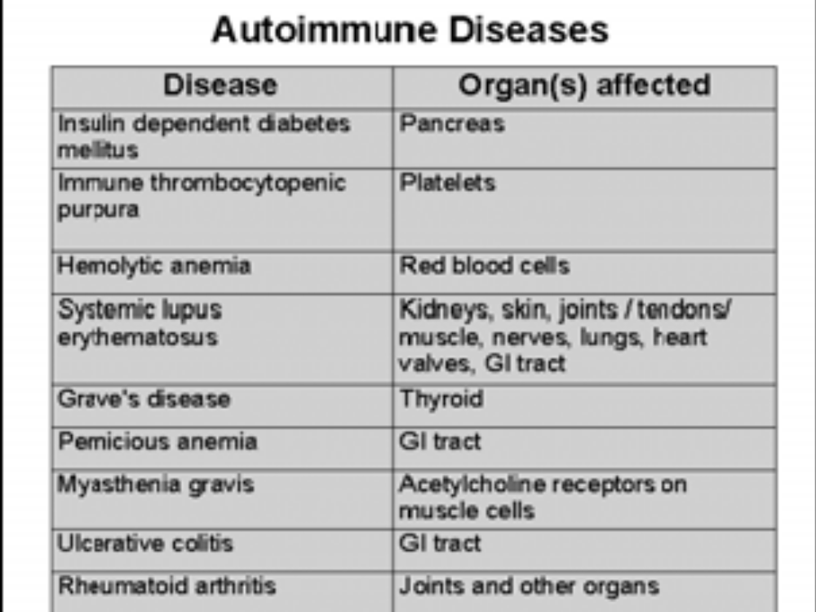

Slide 10
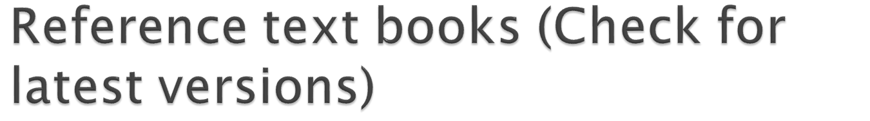
Immunology by Ivan Roitt, Jonathan Brostoff, and David Male
Kuby Immunology
Basic Immunology by Abul K. Abbas and Andrew H. Lichtman
Immunobiology - the immune system in health and disease, by Charles Janeway, Jr. and Paul Travers

